Slide 1



Combat Elite
View in Power BI
Last data refresh:
31/08/2024 18:35:10 UTC
Downloaded at:
31/08/2024 18:47:00 UTC

Slide 2
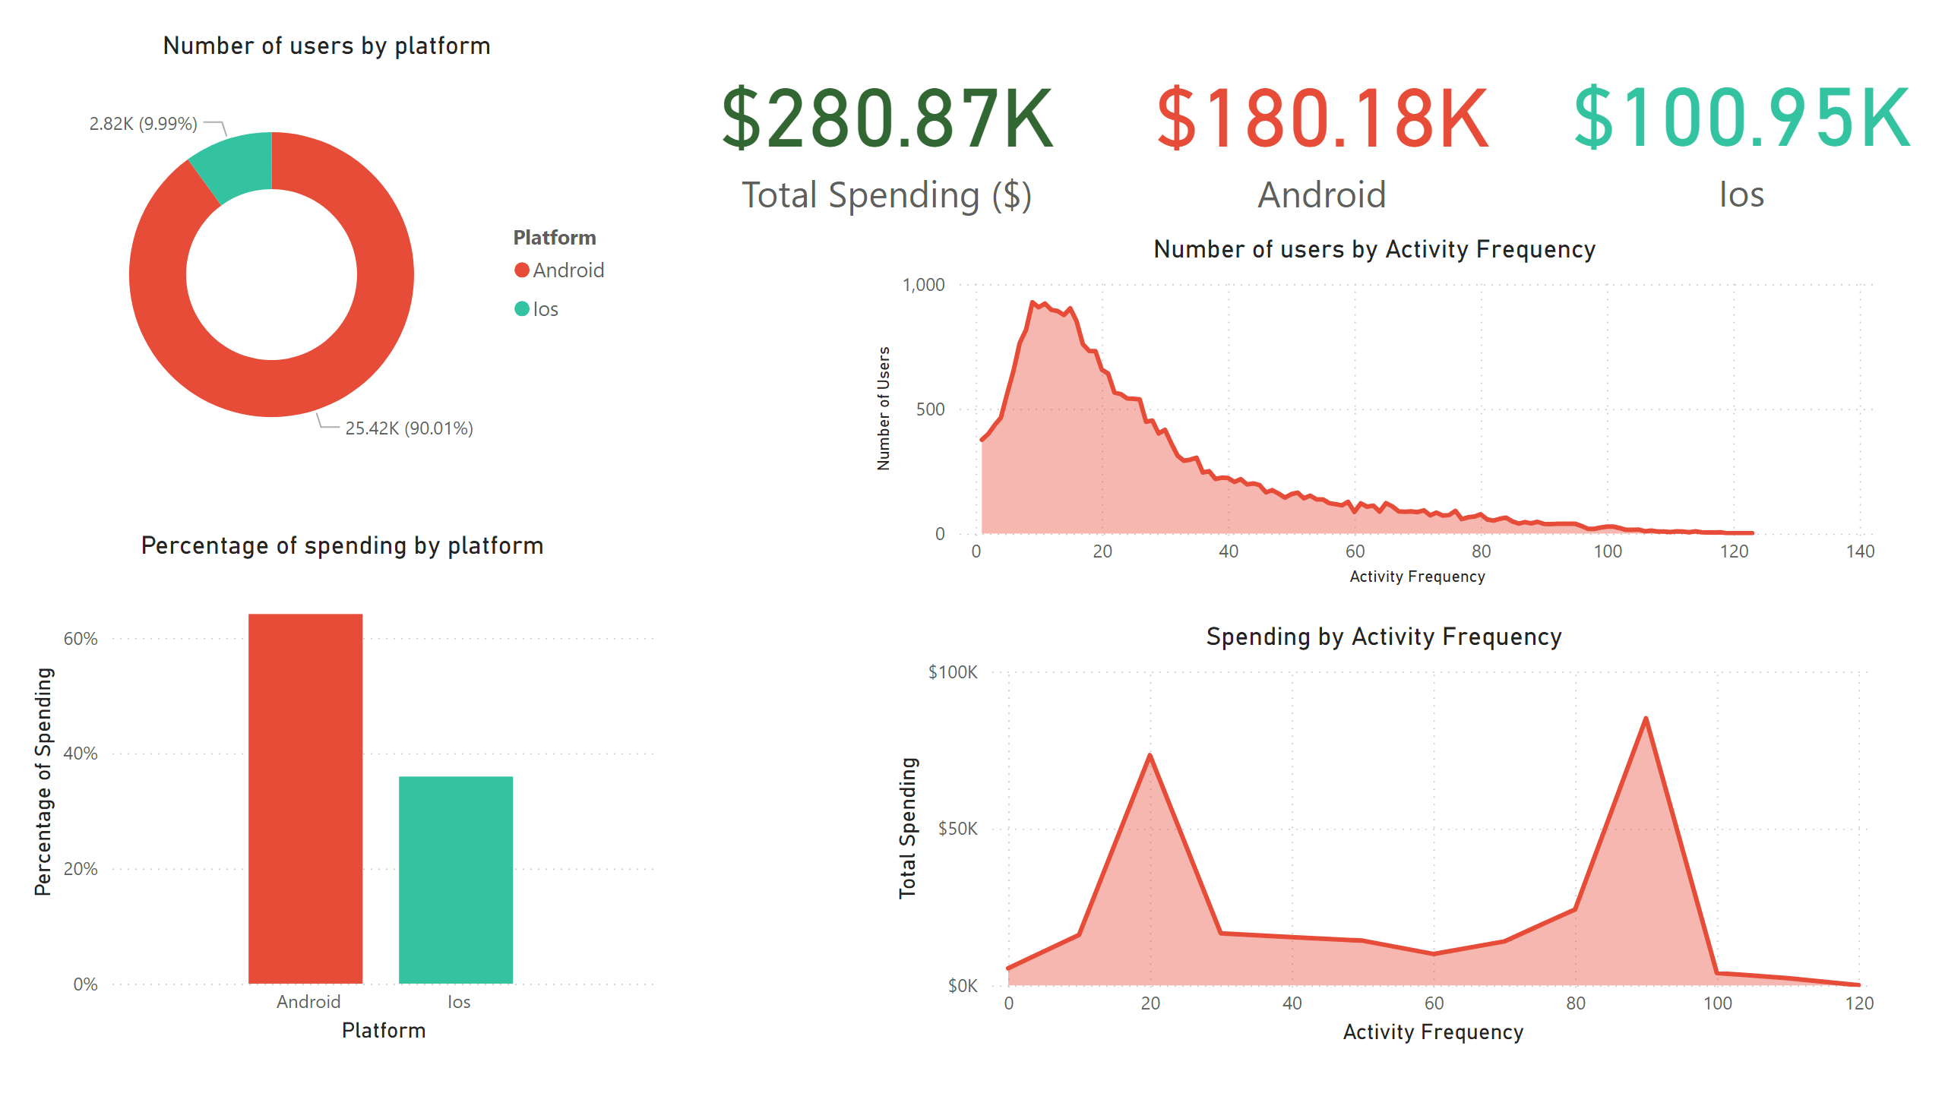
Android vs Ios
Notes:
Number of users by platform
No alt text provided
card
No alt text provided
Percentage of spending by platform
No alt text provided
card
No alt text provided
card
No alt text provided
Spending by Activity Frequency
No alt text provided
Number of users by Activity Frequency
No alt text provided

Slide 3
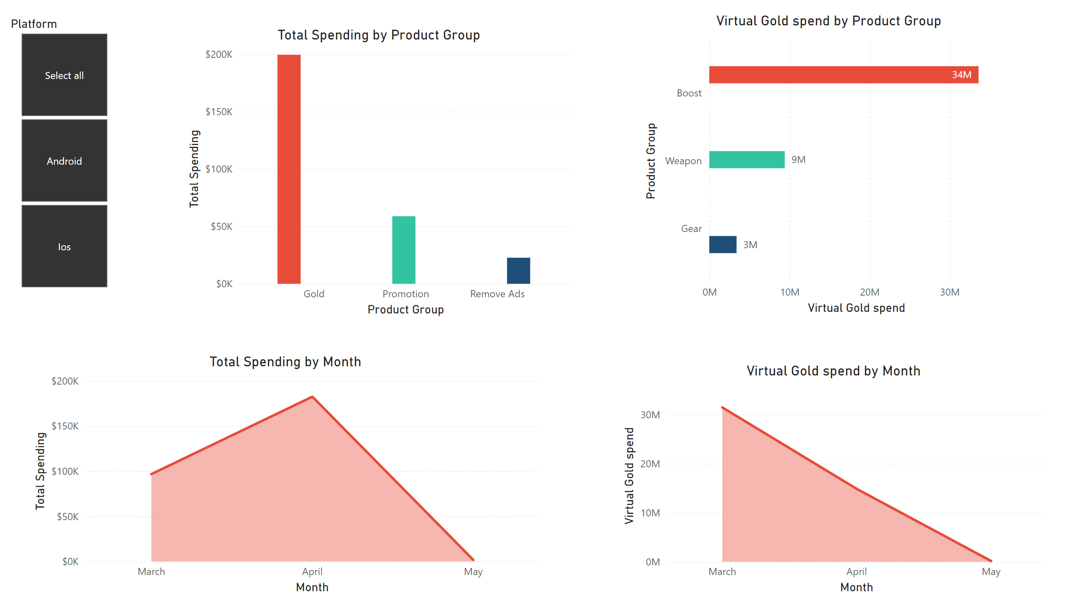
Spending in detail
Notes:
Total Spending by Product Group
No alt text provided
Virtual Gold spend by Product Group
No alt text provided
stackedAreaChart
No alt text provided
areaChart
No alt text provided
slicer
No alt text provided

Slide 4
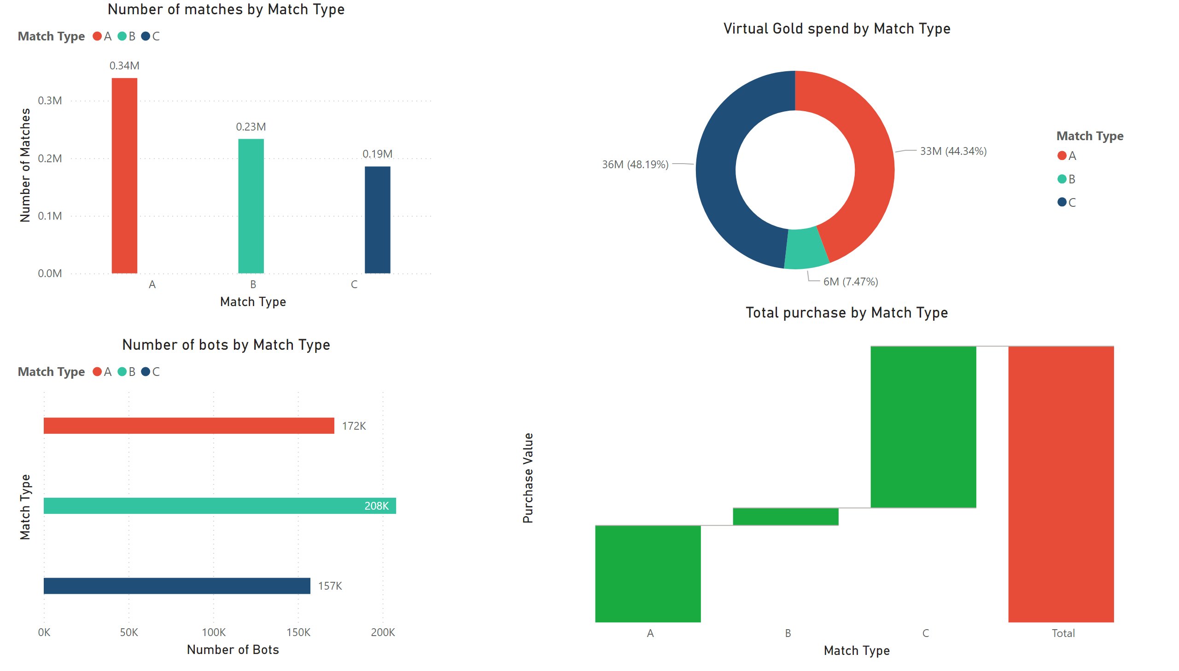
Spending vs Match Type
Notes:
Number of matches by Match Type
No alt text provided
Total purchase by Match Type
No alt text provided
Number of bots by Match Type
No alt text provided
donutChart
No alt text provided

